Slide 1
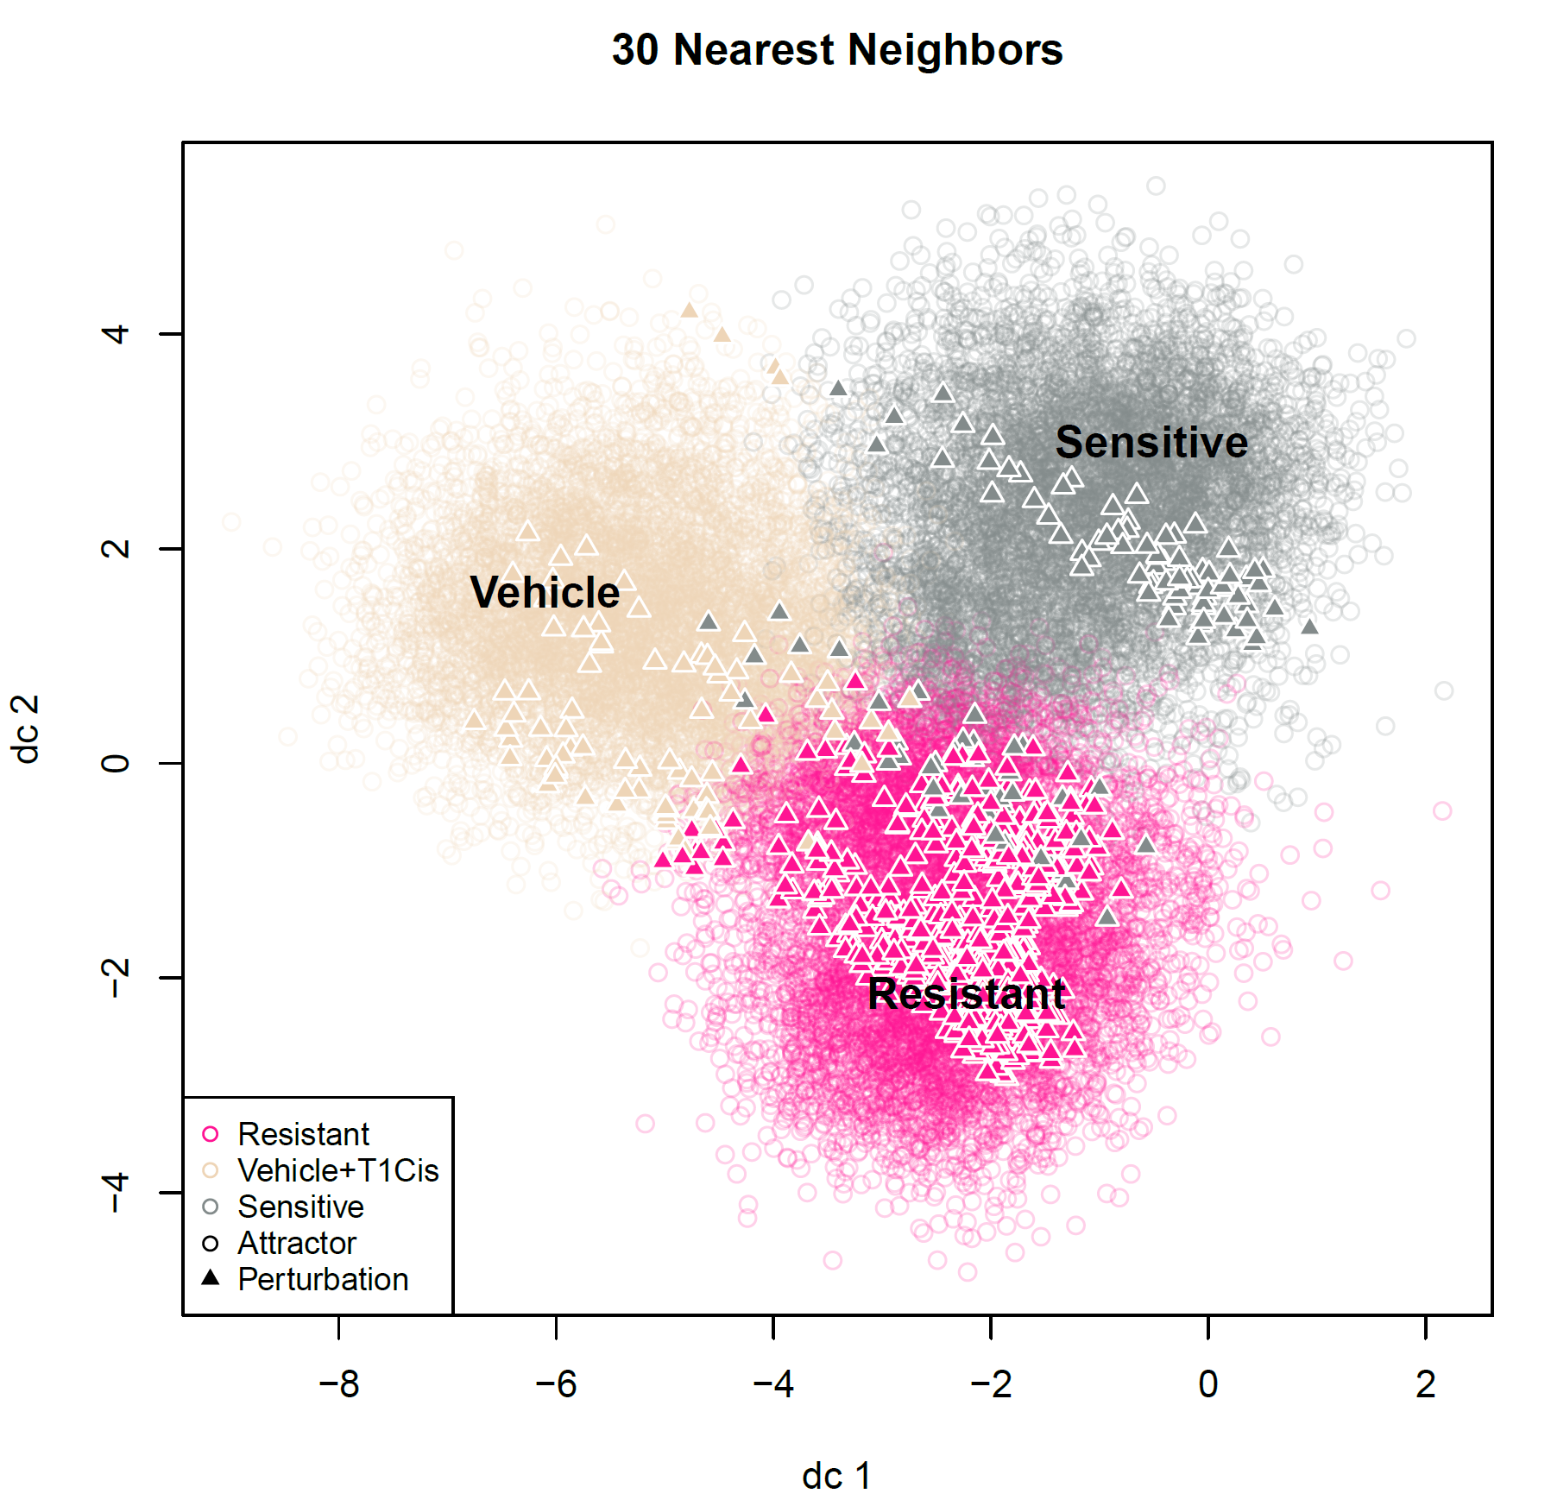
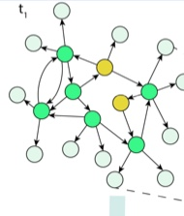
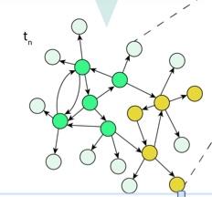

Slide 2

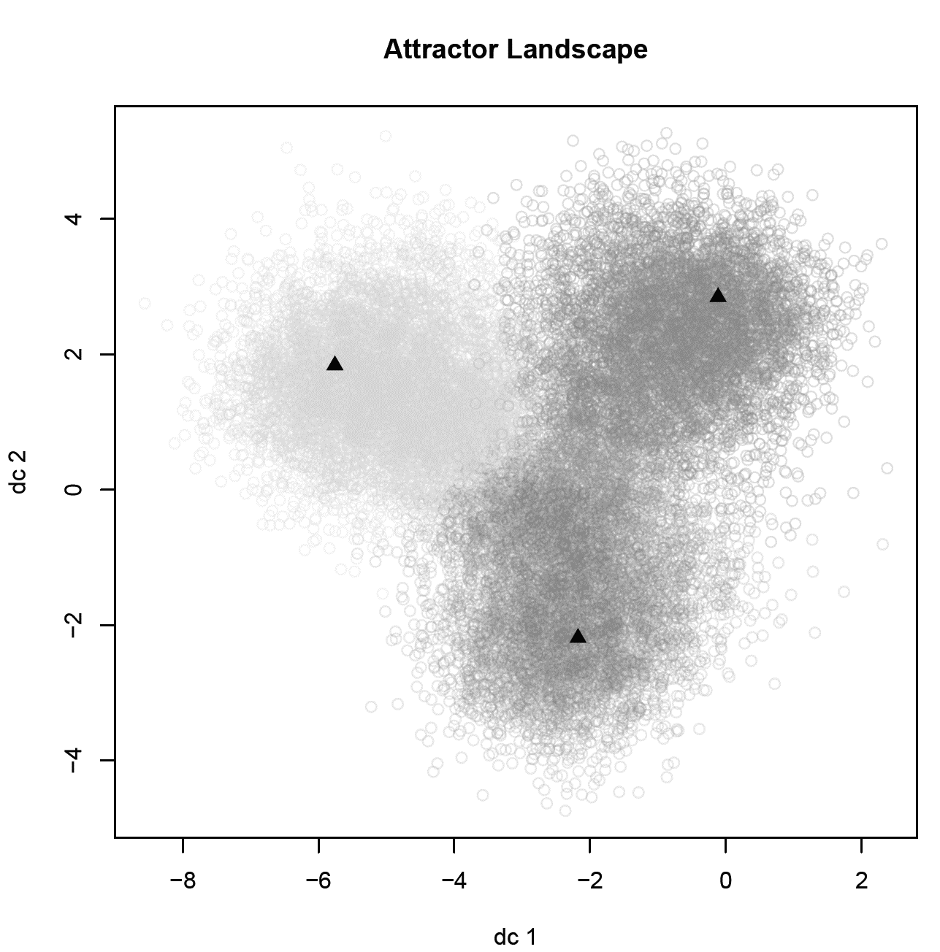
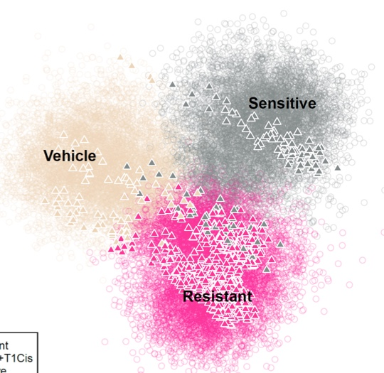
Network Initial Conditions
Feature Vector
(Assoc. Network Attractor States)
Classified Attractors
(by K-Means)
Simulating network to
identify associated attractor
from each initial condition
Classify Newly Generated Attractor from
Perturbed FC (by K-Nearest-Neighbors)
Simulating network to
identify associated attractor
from initial condition
with FC nodes perturbed
?
?
?

Slide 3
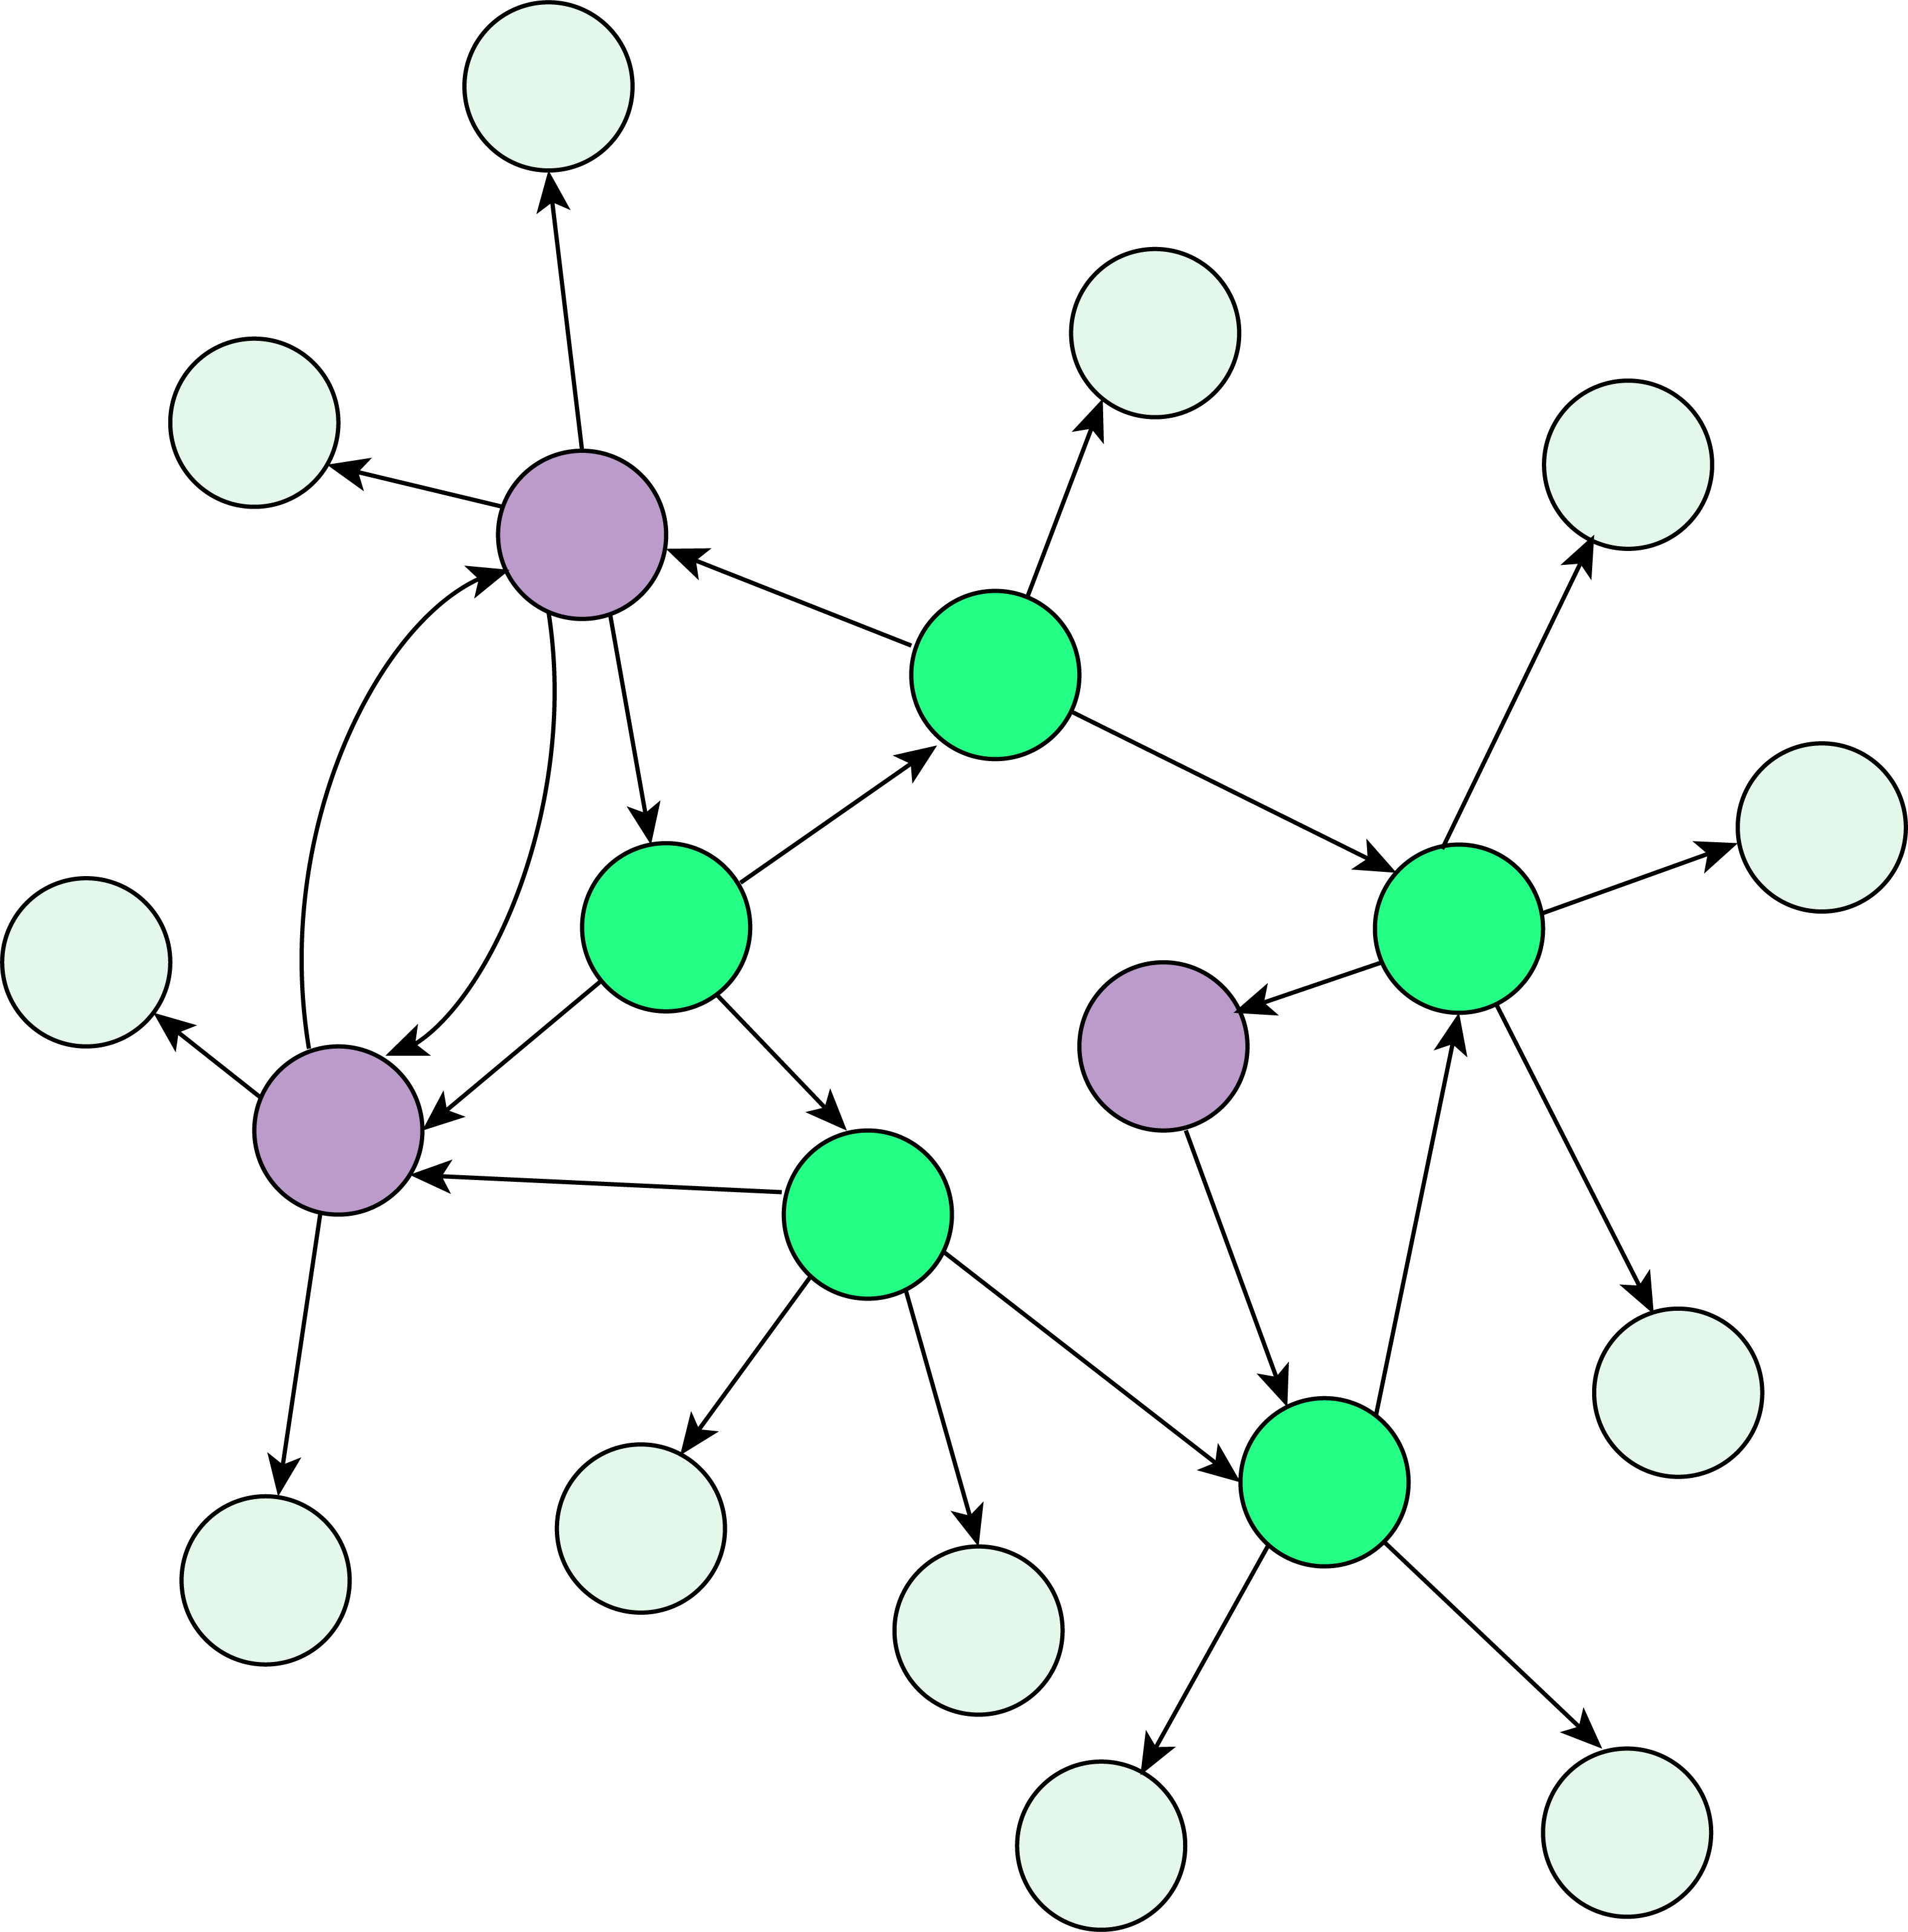
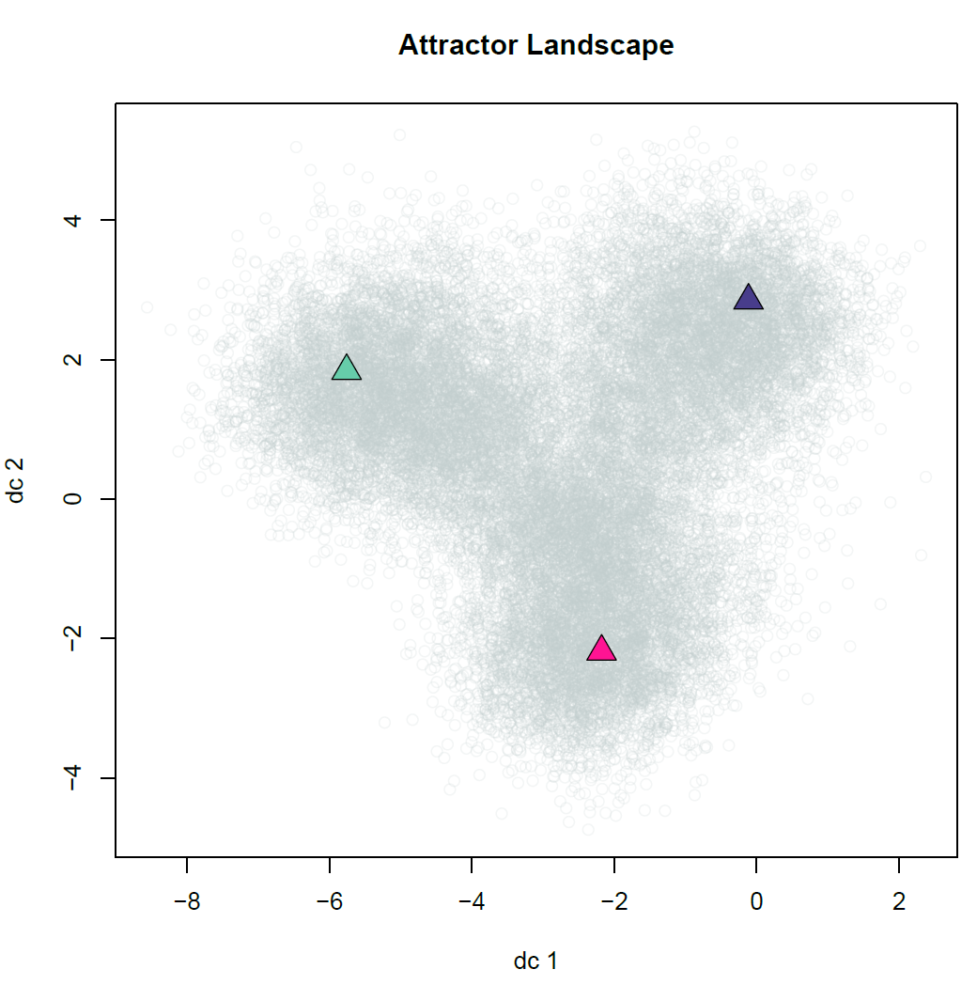
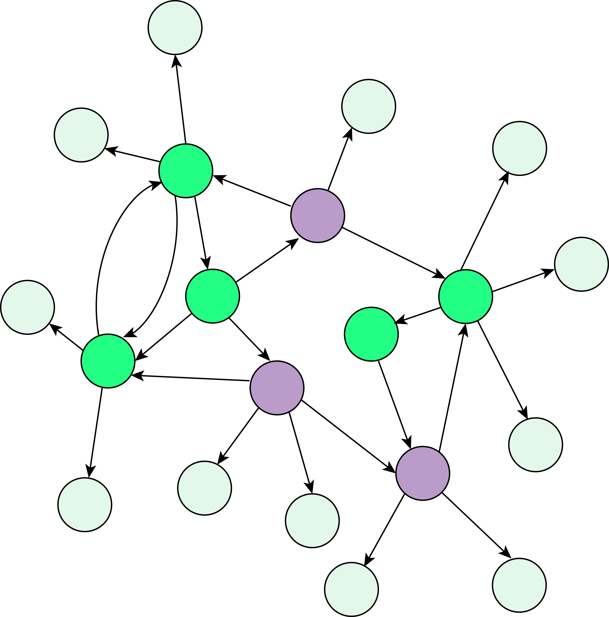
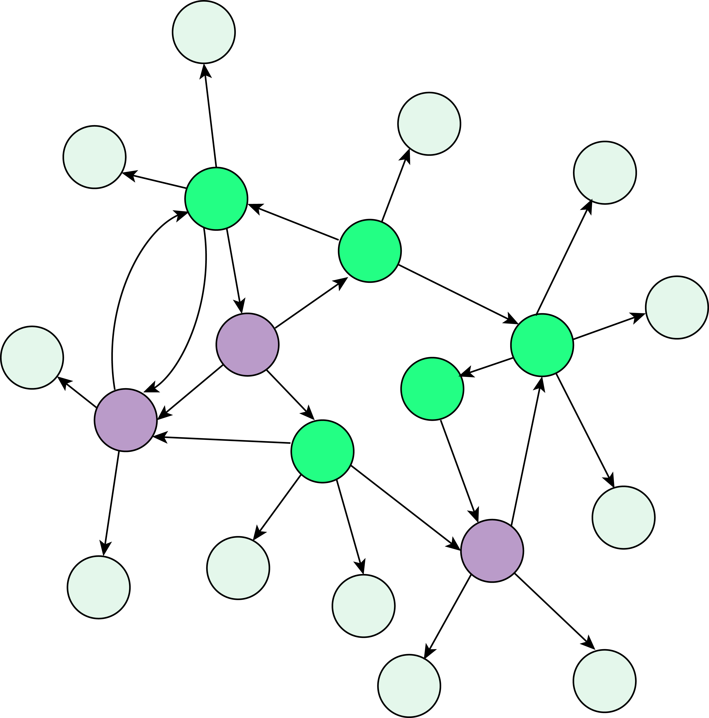
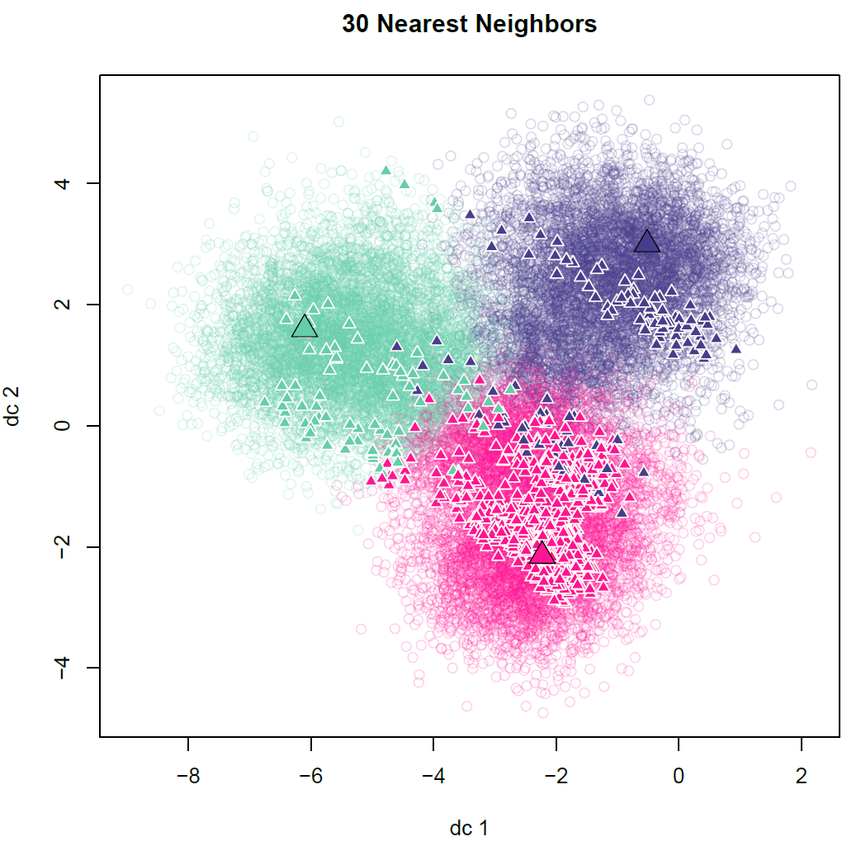
T0_{Vehicle}
Classified Attractors
(by K-Means)
Simulating network to
identify associated attractor
from each initial condition
T0_{Sensitive}
T0_{Resistant}
…
…
T0
V₀
Sen₀
Res₀
Classify Newly Generated Attractor from
Perturbed FC (by K-Nearest-Neighbors)
Simulating network to
identify associated attractor
from initial condition
with FC nodes perturbed
?
?
?

Slide 4
Classified Attractors
(by K-Means)
T0_{Normal}
Simulating network to
identify associated attractor
from each initial condition
T0_{Cancer}
…
…
T0
Norm₀
Ca₀
Classify Newly Generated Attractor from
Perturbed FC (by K-Nearest-Neighbors)
Simulating network to
identify associated attractor
from initial condition
with FC nodes perturbed
?
?
?

Slide 5
Classified Attractors
(by K-Means)
T0_{Cancer}
Simulating network to
identify associated attractor
from each initial condition
T0_{Normal}
…
…
T0
Ca₀
Norm₀
Classify Newly Generated Attractor from
Perturbed FC (by K-Nearest-Neighbors)
Simulating network to
identify associated attractor
from initial condition
with FC nodes perturbed
?
?
?

Slide 6
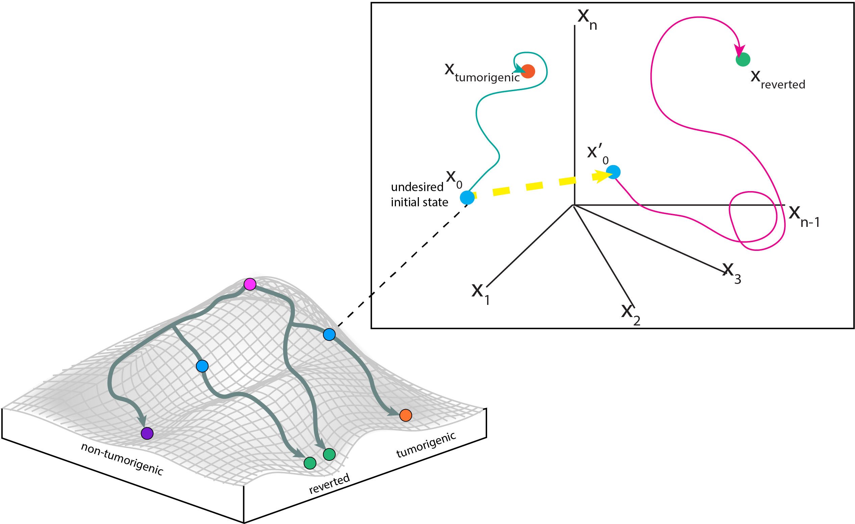

Slide 7
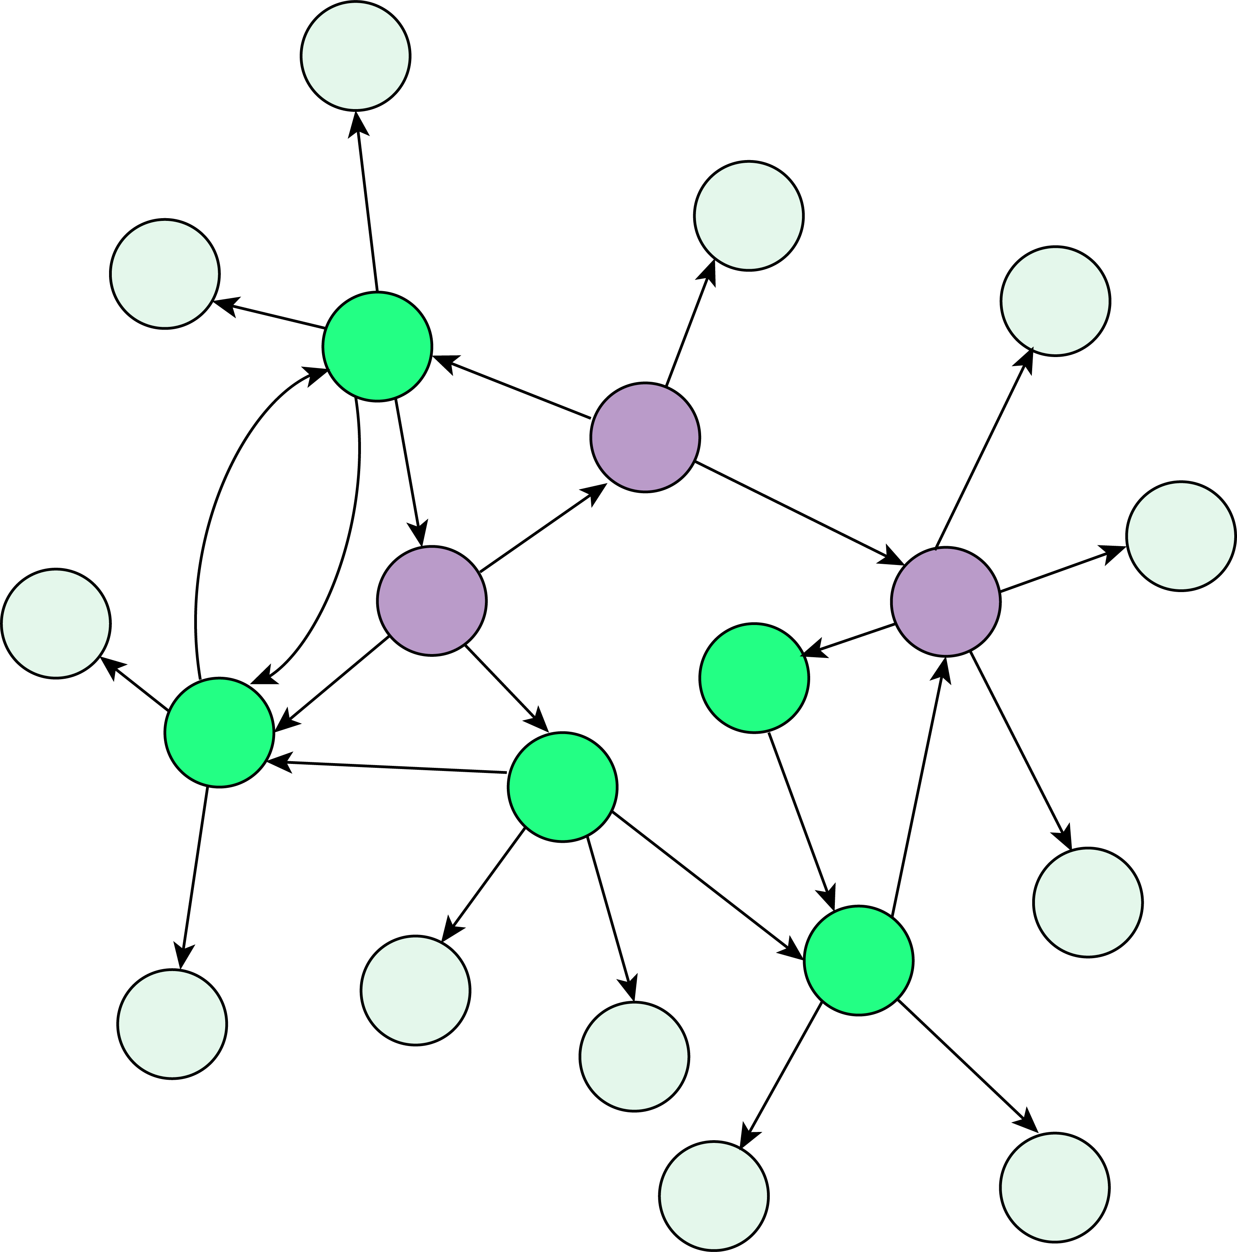
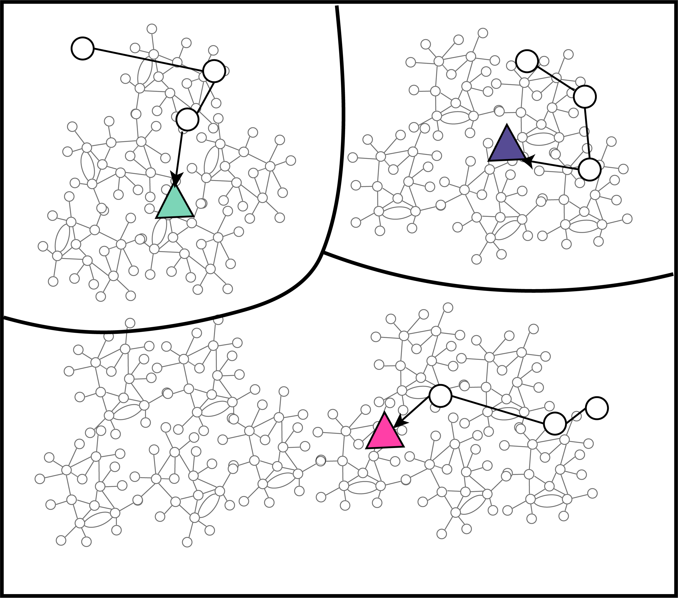
Norm₀
Other₀
Network nodes in arbitrary basal state
Network nodes in basal state as normal
Ca₀
Network nodes in basal state as cancerous
Figure 3. Attractor landscape including the associated attractors for the 2 conditions of interest: Cancerous (Ca) and Normal (Norm)

Slide 8
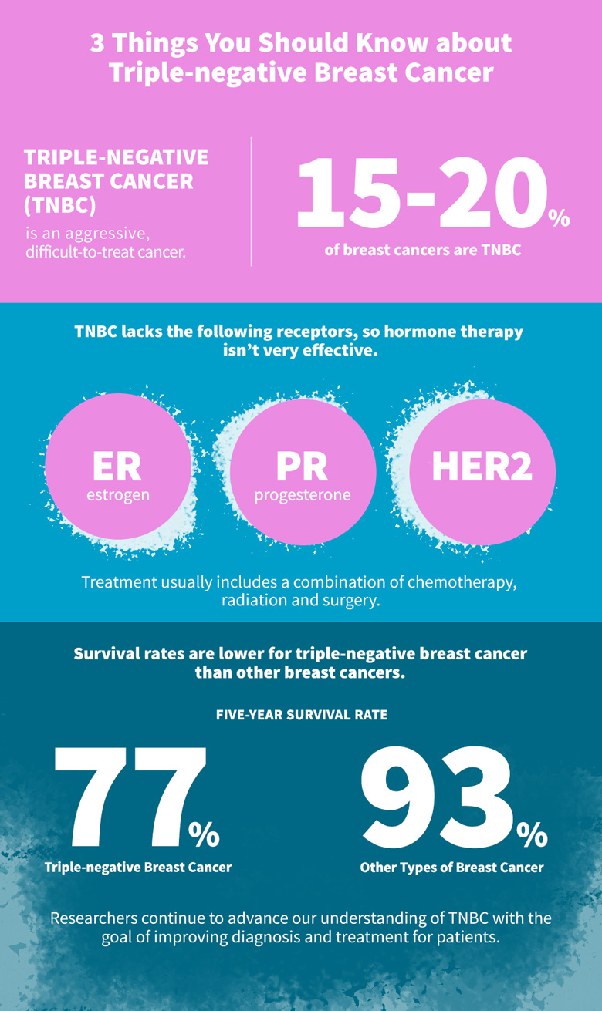
Figure 1. Waddington’s Epigenetic Landscape and Optimal Control on State Space Portrait
Figure 1. Waddington’s Epigenetic Landscape and Optimal Control on State Space Portrait

Slide 9
Triple Negative Breast Cancer (TNBC)
An Aggressive Subtype of Breast Cancer
20%
of Breast Cancers are TNBC
Claudin-Low TNBC
A subtype of TNBC accounting for 7-14% of all invasive breast cancers
Lacks these receptors so targeted therapies aren’t effective
ER
estrogen
PR progesterone
HER2

Slide 10
Triple Negative Breast Cancer (TNBC)
An Aggressive Subtype of Breast Cancer
Claudin-Low (CL) TNBC
A Subtype of Triple Negative Breast Cancer
20%
of Breast Cancers are TNBC
7-14%
of invasive Breast Cancers are CL TNBC
Lacks these receptors so targeted therapies aren’t effective
These characteristics lead to high rates of metastasis and poor response to cytotoxic drugs
EMT
Undergoes Epithelial to Mesenchymal Transition
Stemness Exhibits stem-cell like characteristics
ER
estrogen
HER2
PR progesterone
Proliferation
Low proliferation rates

Slide 11
The constructed network has 230 nodes and 583 edges (Fig 6). 90 of the nodes are hallmarks of cancer, 27 are breast disease ontology associated, and 4 are claudin-low markers. 142 of the network nodes are in the ACSN. (SOURCES)

